Slide 1
MODULE 3
SEMANTIC NETWORKS

Slide 2
Knowledge Representation
Knowledge Representation, is an integral part of Artificial Intelligence (AI).
It works along with Reasoning to enable machines to comprehend and represent accumulated data and knowledge in a reasoning way.
It is concerned with thinking and how it contributes to intelligent machines.
Moreover, it uses various techniques to accomplish an accurate representation of knowledge. These techniques are:
  Logical Representation.
  Semantic Networks.
  Production Rules.
  Frames Representation.

Slide 3
SEMANTIC NETWORKS IN AI
Semantic Networks or Semantic Net is a knowledge representation technique used for propositional information.
Semantic Network is a directed or undirected graph consisting of vertices.
These vertices represent concepts and edges, which further represent semantic relations between concepts, mapping or connecting semantic fields.

Slide 4
COMPONENTS OF SEMANTIC NETWORKS:
Semantic Networks can further be defined by specifying its fundamental components, which are:
Lexical Components - Consists of:
Nodes represent the object or concept.
  Links: Denoting relation between nodes.
  Labels: Denoting particular objects & relations.
Structural Component - Here the links and nodes form a directed graph wherein the labels are placed on the link and nodes.
Semantic Component - The meanings here are related to the links and labels of nodes, whereas the facts are dependent on the approved areas.
Procedural Part - The creation of new links and nodes is permitted by constructors, whereas the destructors are responsible for the removal of links and nodes.

Slide 5
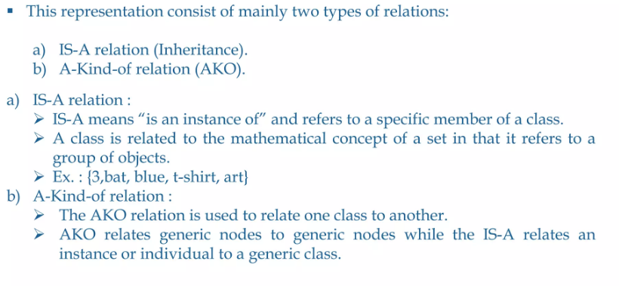
Semantic network Representation

Slide 6
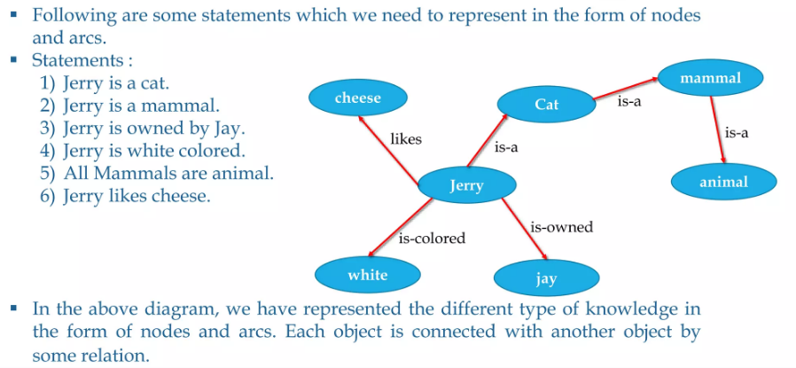
Simple example of Semantic Networks

Slide 7
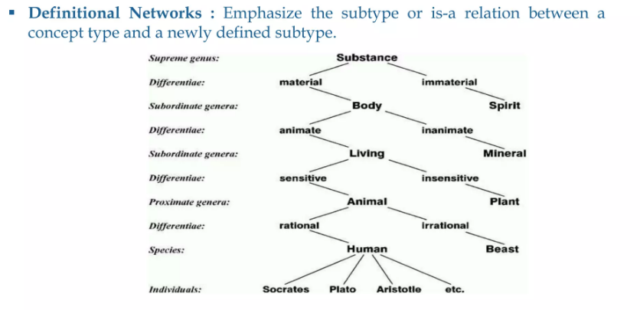
Types of Semantic Networks

Slide 8
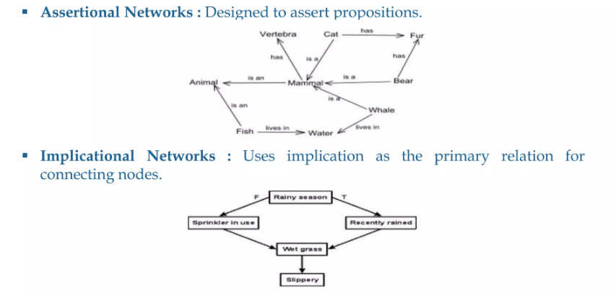

Slide 9
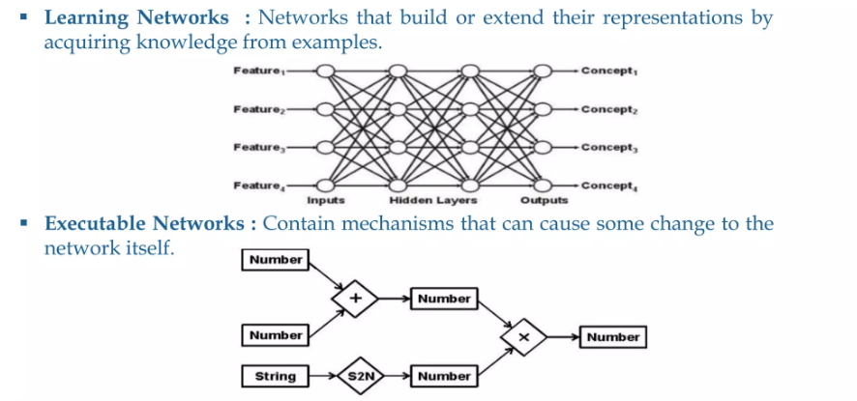

Slide 10
APPLICATION OF SEMANTIC NETWORKS:
In natural language processing applications like semantic parsing, word sense disambiguation, etc.
Specialized retrieval tasks, like plagiarism detection.
Knowledge Graph proposed by Google in 2012 uses semantic networks in the search engines.

Slide 11
ADVANTAGES OF SEMANTIC NETWORKS:
It is simple and comprehensible.
Efficient in space requirement.
Easily clusters related knowledge.
It is flexible and easy to visualize.
It is a natural representation of knowledge.
Conveys meaning in a transparent manner.

Slide 12
DISADVANTAGES OF SEMANTIC NETWORKS:
Inheritance cause problems.
Links on objects represent only binary options.
Interactable for large domains.
Don’t represent performances or meta-knowledge effectively.
It’s difficult to express some properties using Semantic Networks, like negation, disjunction, etc.

